Slide 1


Rao Birender Singh State Institute of Engineering & Technology
Zainabad-123411
Ignite Innovation
Tech Fest

Slide 2
ANVA
YOUTUBE THUMBNAIL EDITOR

Slide 3

OUR TEAM
SACHIN THAKUR
SHIV KUMAR
JAYANT
Responsibilities
Coding
Managing Team
Responsibilities
Frontend Designing
Tools Ideas
Responsibilities
Tools Designing
Focus to make it easy

Slide 4

PROBLEM IDENTIFICATION
01.
Attractive Thumbnail is most important thin in YouTube Video
02.
New Creator have Less Knowledge about making attractive
Thumbnail and suitable Title
03.
There are No Easy Software to Make Thumbnail of YouTube
04.
No Light Software Which can run Live on Browsers
05.
There are no Editing App which focus on YouTube
Thumbnails and Content Creators

Slide 5
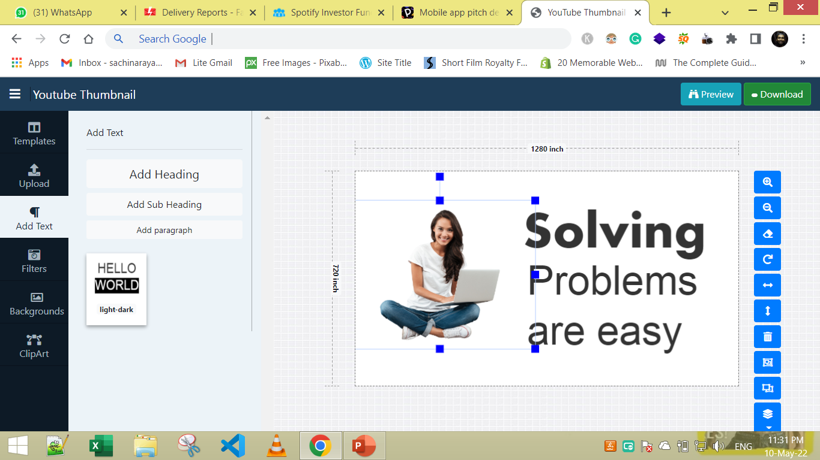
SOLUTION
ANVA
YOUTUBE THUMBNAIL EDITOR
ANVA is Easy to Use
ANVA Provide Ready-Made Templates
No Experience & Knowledge is required to Make Thumbnail
We are using minimalistic Approach to keep the software easy to use

Slide 6





MODEL WORKING
TECHNOLOGIES USED
JavaScript FabricJS (JS Library)
Bootstrap (CSS Library)
Jquery (JS Library)
HTML
CSS

Slide 7
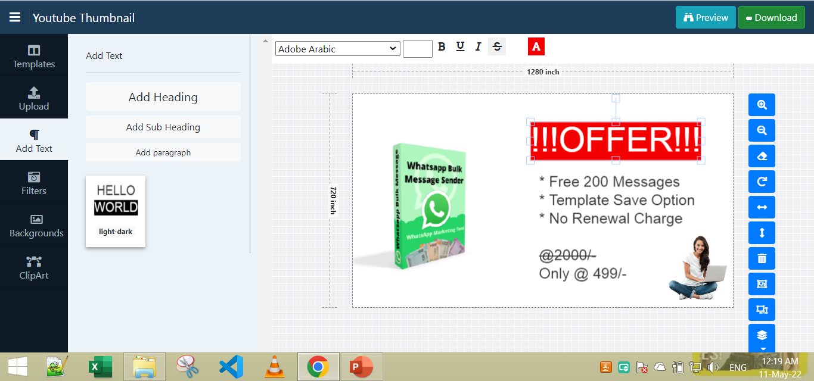
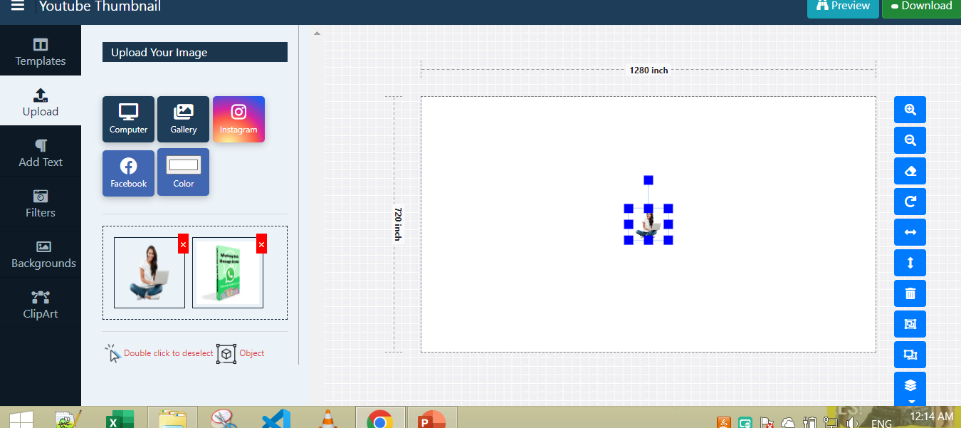

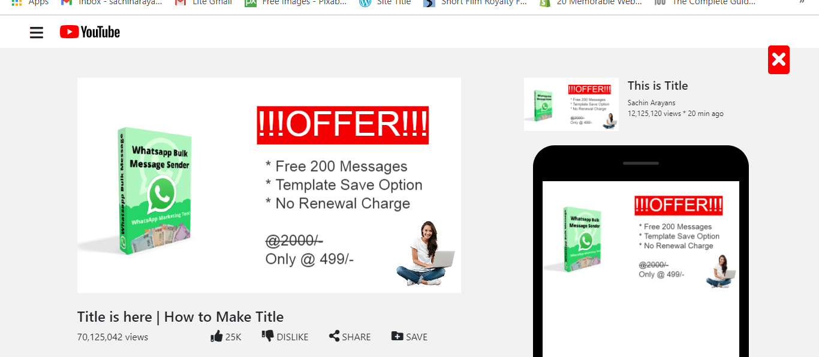
MODEL WORKING
01. Upload
02. Design
03. Preview
04. Download

Slide 8
POPULATION WILL BE AFFECTED
2.6 Billion
50 Million
46.7 Million
Total People Affected
(Direct & Indirect) YouTube Users
Total People Affected
(Direct )
Content Creator
Total People Affected
(Direct & Indirect)
Amateurs Content Creator
Source
https://influencermarketinghub.com/creator-economy-stats/#:~:text=There%20are%20approximately%2037%20million,time%20watching%20other%20people's%20content.

Slide 9



FUTURE SCOPE
COMMUNITY BASED SOLUTION
AI BASED OPTIONS
MINIMILASTIC APPROACH

Slide 10
THANK YOU

